Slide 1
VETERINARY HUB
GUIDED BY J.B PATEL
Prepared by Luhar Faizal 206240307058
Kanetiya Jaivikbhai 206240307055

Slide 2
Overview of Project
Introduction
Scope and Objective
System Requirement
Flowchart & Uml Diagram
Conclusion & reffrence

Slide 3
Introduction
Animal rescue is a much needed social service that helps protect animals from dangerous situations that often involve cruelty and use.
Many animals are turned into shelters due to evictions, expensive health concerns, or other unavoidable circumstances.
Save animal life and efforts to prevent animal deaths from road accidents.
It saves time, paperwork is less, and easy retrieval of records, automating the process of middle man who takes a commission.

Slide 4
Scope and objevctive
Freedom from pain, injury or diseases by prevention or rapid diagnosis and treatment.
Owner has not informs to where is animals.
It saves time, paperwork is less, and easy retrieval of records, automating the system reduces the process of middle man who takes a commission.
To provide ease of working towards the welfare of abandoned, stray, lost, or surrendered pets.
The main objective of this project is to automate the process of serving towards the welfare of the pets by giving the abandoned pets a place of shelter, care for them with affection

Slide 5
System Requirement
1. HARDWARE:
Processor:- Intel Core i5
Ram:- 4 GB
HDD:- 200 GB
2. SOFTWARE:
Operating System:- Windows 7/8/10, Max OS X
Browser:- Chrome, MS Bing etc.

Slide 6
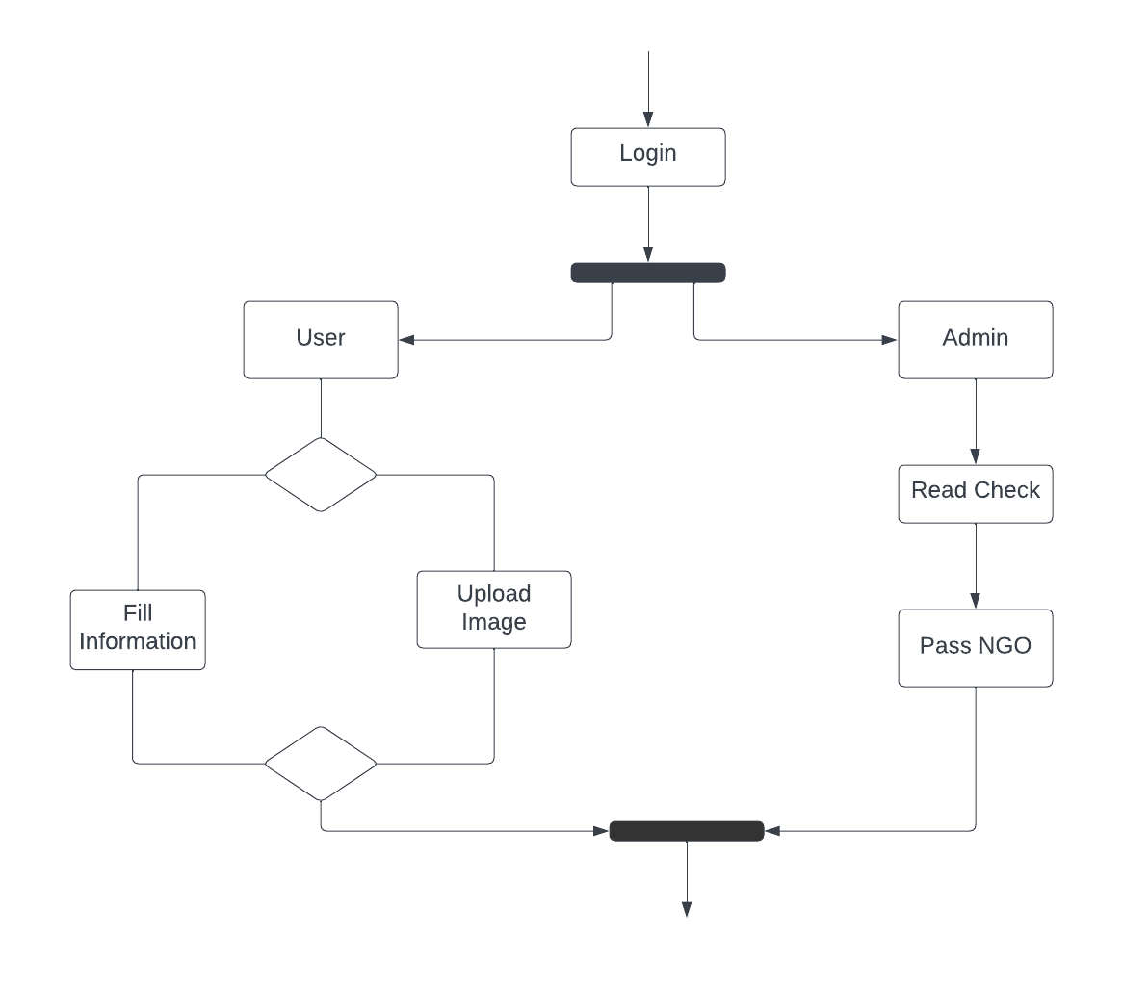
Flowchart & UML Diagram

Slide 7
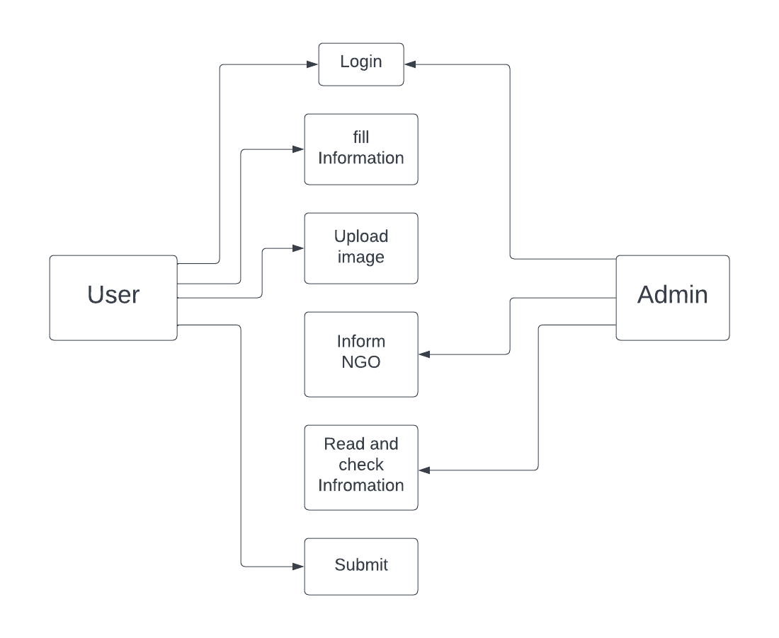
Use case diagram

Slide 8
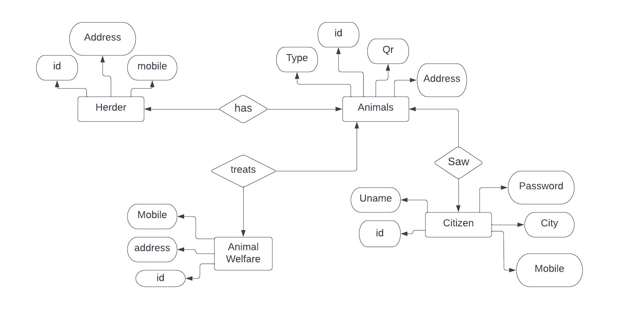
ER Diagram

Slide 9
Data Dictionary
Login Table
Attribute | Data Type | Size | Contrains | Description
User id | Number | 10 | Primary key | User ID
User Name | Varchar | 40 | Not Null | Name of user
Password | Varchar | 10 | Not Null | Login Password
Contact No | Varchar | 10 | Not Null | Contact to user
Email | Number | 40 | Not Null | User mail

Slide 10
Admin Table
S. No. | Attribute | Data Type | Constraint
1. | Name | Varchar2 | Not NULL
2. | User ID | Varchar2 | Not NULL
3. | Email ID | Varchar2 | Not NULL
4. | Password | Varchar2 | Not NULL

Slide 11
Enquiry Table
S. No. | Attribute | Data Type | Constraint
1. | ID | Integer | Primary key
2. | Animal ID | Varchar2 | Not NULL
3. | User ID | Varchar2 | Not NULL
4. | Name | Varchar2 | Not NULL
5. | Email ID | Varchar2 | Not NULL
6. | Contact | Number | Not NULL
7. | Message | Varchar2 | Not NULL

Slide 12
Animal Table
S. No. | Attribute |  | Data Type | Constraint
1. | ID |  | Integer | Not NULL
2. | Category ID |  | Varchar2 | Not NULL
3. | Animal name |  | Varchar2 | Not NULL
4. |  | Disease type | Varchar2 |  | Not NULL
5. |  | Treatment Time | Varchar2 |  | Not NULL

Slide 13
CONCLUSION:
At the end of the project, we have successfully implemented the functionalities of our system as it was proposed.
We are able to provide an interface between the user and to access the entire system.
Further, we provide a system the monitors by admin. Our main objective is to save animals.
. If anything happens to animals our service will be provided in shortly.

Slide 14
You…
Thank

